Slide 1
A study of the Fermi bubbles near the Galactic plane
Dmitry Malyshev,
Laura Herold
Fermi LAT diffuse meeting
August 15, 2017

Slide 2
General information about the project
People involved: Dima Malyshev, Laura Herold
Category of project: II
Follow up work on the bubbles
Some results on the bubbles at low latitudes were already published in:
the Fermi LAT diffuse paper (arxiv:1602.07246)
the pass 8 GC analysis paper (arxiv:1704.03910)

Slide 3
Motivation
Origin of the Fermi bubbles
AGN-like emission from Sgr A*
Bubbles are expected to have an hour-glass shape centered at the GC
Starburst / star formation
Bubbles don’t need to be centered at the GC

Slide 4
Properties of the bubbles at high latitudes
Fermi LAT bubbles analysis paper (arxiv:1407.7905)
Bubbles at latitudes |b| > 10 deg
Homogeneous spectrum with a cutoff around 100 GeV
Homogeneous intensity + cocoon

Slide 5
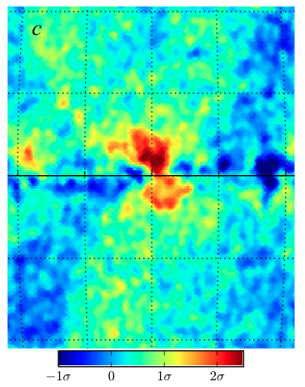
Previous analysis near the Galactic plane
Hints of a different behavior near the Galactic center
No cutoff at high energies
Higher intensity near the GC
Displaced from the GC to the right (negative longitudes)
Fermi LAT diffuse model
Acero et al (2016) arxiv:1602.07246
Pass 8 GC analysis Ackermann et al (2017)
arxiv:1704.03910

Slide 6
This analysis
Data selection:
Pass 8 Source class (relatively small area)
8 years (August 4, 2008, - August 3, 2016)
Energies between 300 MeV – 1 TeV in 24 logarithmic energy bins
HEALPix pixelation order 7 (resolution 0.5°)
Analysis strategy:
Very simple model using low-energy Fermi data → not many assumptions necessary
Comparison with GALPROP model

Slide 7
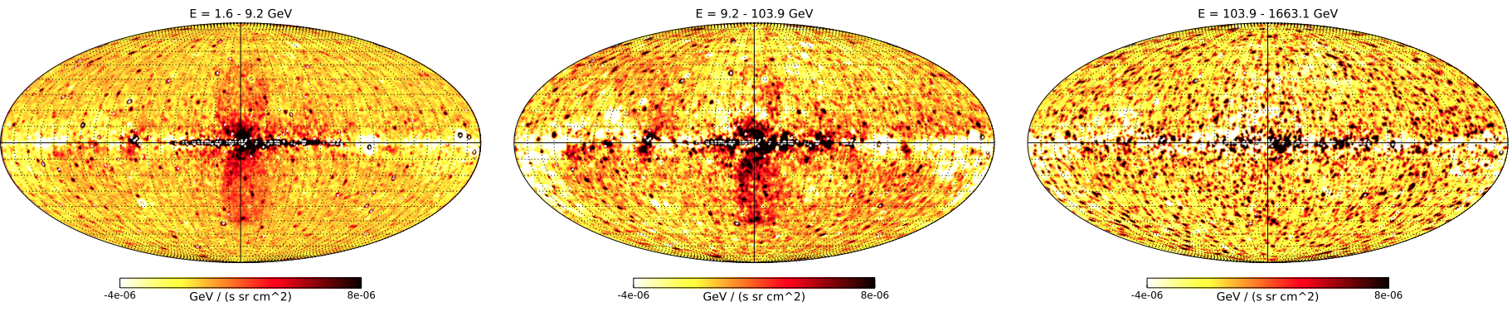
The low-energy model
Components:
Low-energy Fermi data (600 Mev – 1.6 GeV) as a spatial template for foreground (softer spectrum than bubbles): N_{low}
Constant value: c
Normalization of N_{low} and c are fitted to higher-energy data in 4 deg latitude stripes
Region of bubbles is excluded (-20 < l < 20 deg)
Point sources are masked

Slide 8
The boxes model
Components:
As before: N_{low}, c
Rectangles of constant value covering the Fermi bubbles: b
Normalization of N_{low} and c and b are fitted to higher-energy data in 4 deg latitude stripes
Point sources are masked

Slide 9
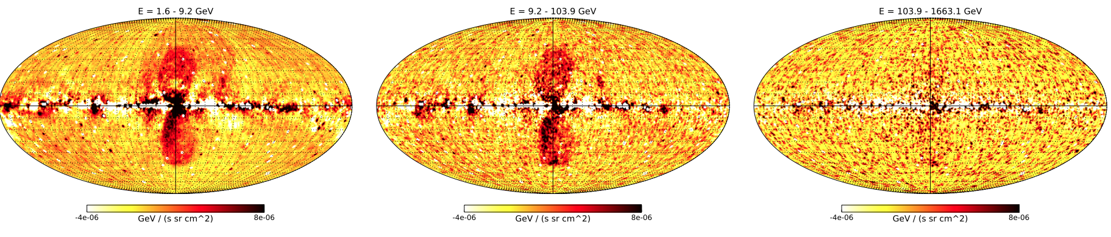
The GALPROP
Components:

Slide 10
Latitude profiles
Longitude profiles east and west of GC (-10 < l < 10 deg)
Left-right asymmetry
Models agree well (on southern hemisphere)

Slide 11
Spectra
→ Left-right asymmetry

Slide 12
Spectra

Slide 13
Spectra

Slide 14
Timeline
End of September: Finish analysis (physics interpretation: fit IC and π⁰ spectra, particle lifetimes, total energy output in terms of SNe)
October: Present more results
End of October: Finish draft

